Slide 1

Pay-Per Trail
Ross Ferguson, Naomi Silver, Matthew Gibson, Ananya Bhatt, Lewis Mclean

Slide 2
The Brief
We were tasked to create a mobile banking app
Focus on environmental impact and transparency
Gamification to incentivise environmentally conscience spending

Slide 3
Initial Planning
Planning our approach.
Agile methodology and team structure
We thought of using Kotlin but ultimately decided against this.
A website intended for mobile use would allow for a multi-platform solution.
Decided to use postgreSQL, a relational database, as our database for this project.

Slide 4
Week 1
Designated for planning out the steps of implementation.
Version control and project management system was to be GitHub and GitHub Projects.
Designing wireframes and ER diagrams.
Roles were decided this week.
Software, such as EC2 and RDS, was set up to allow for development next week.

Slide 5
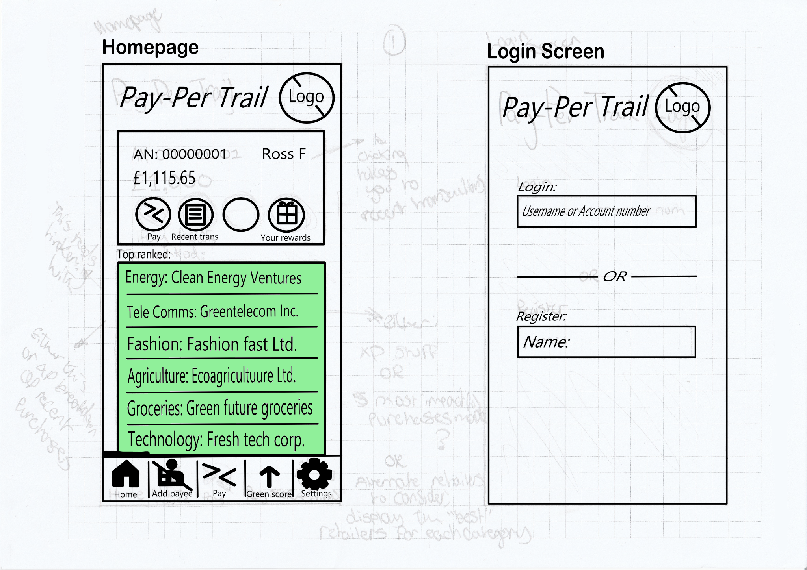
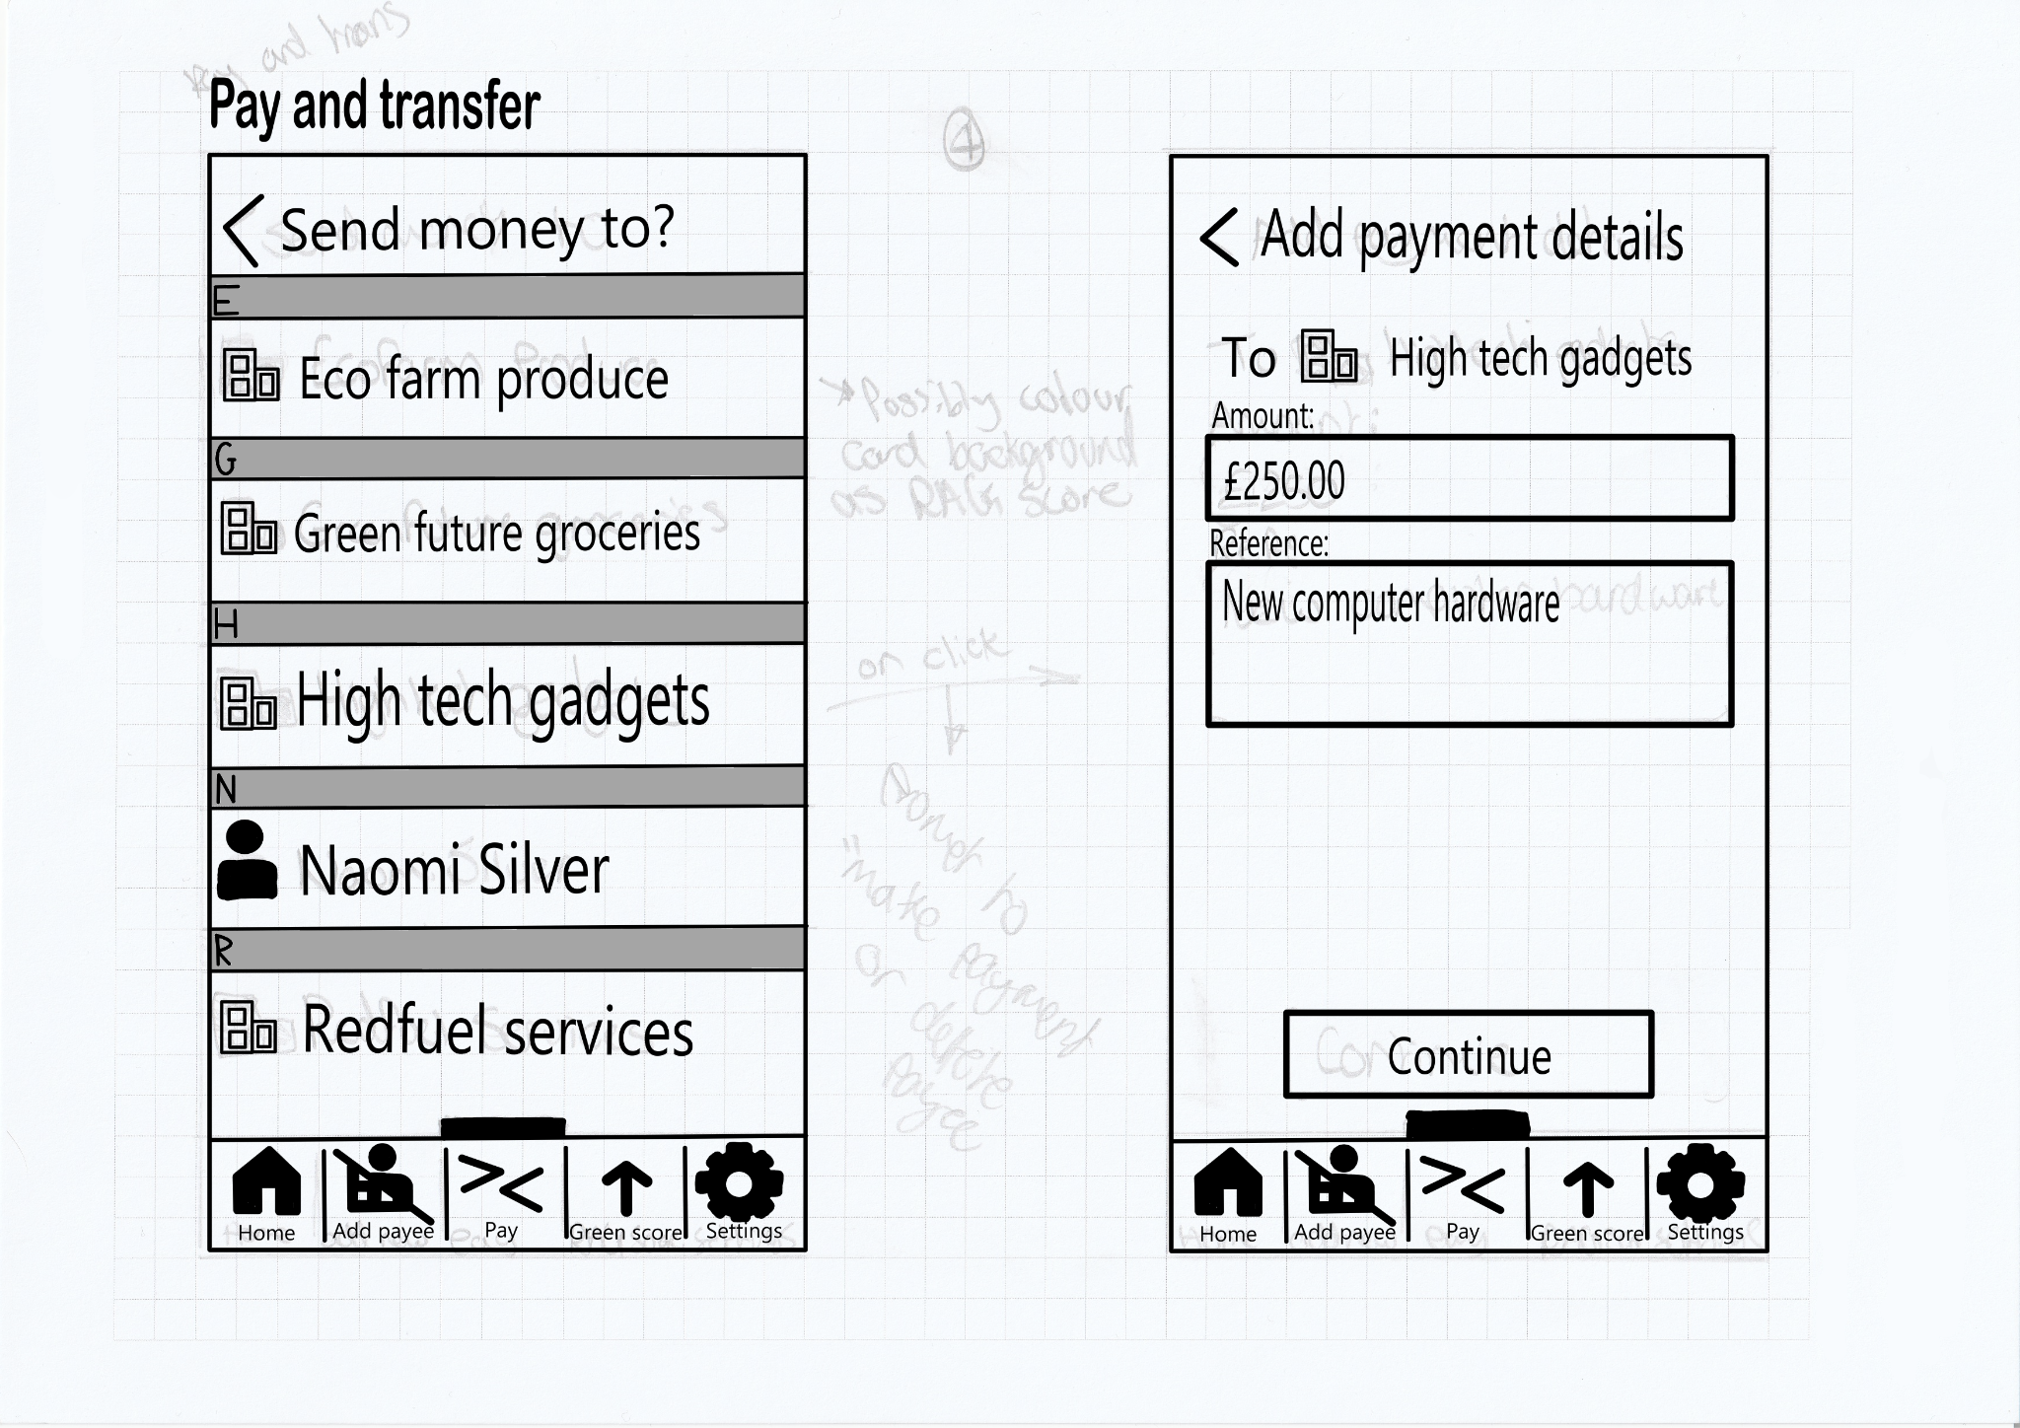
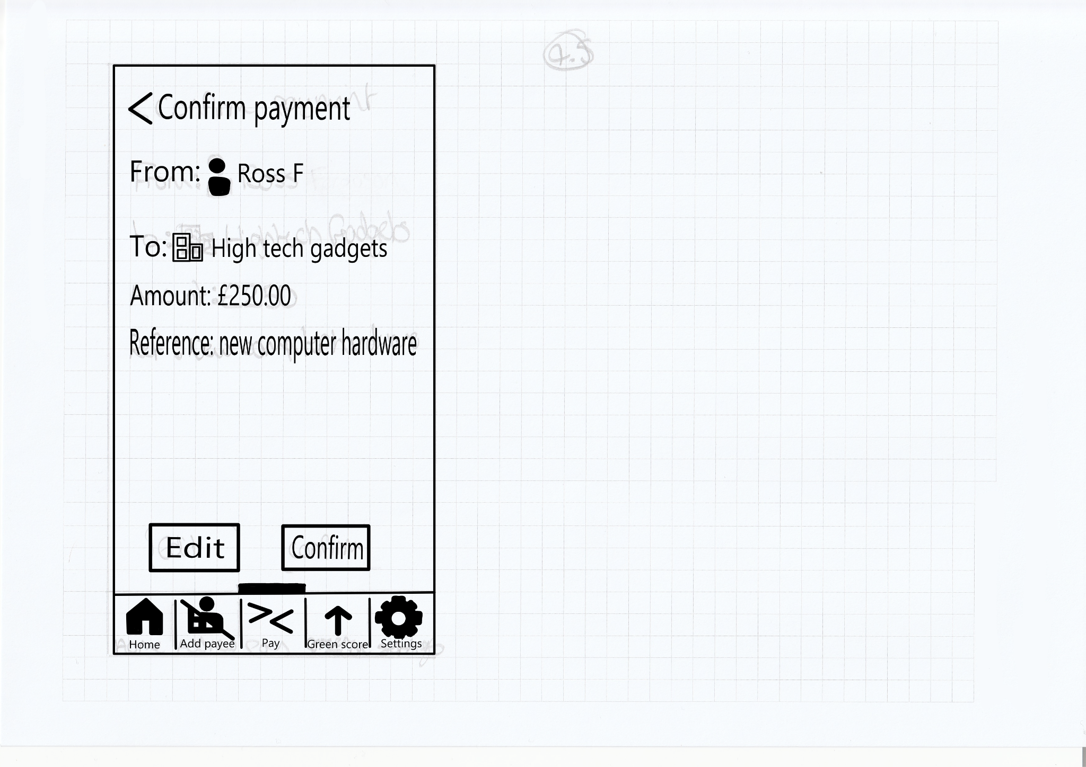
Website Structure

Slide 6
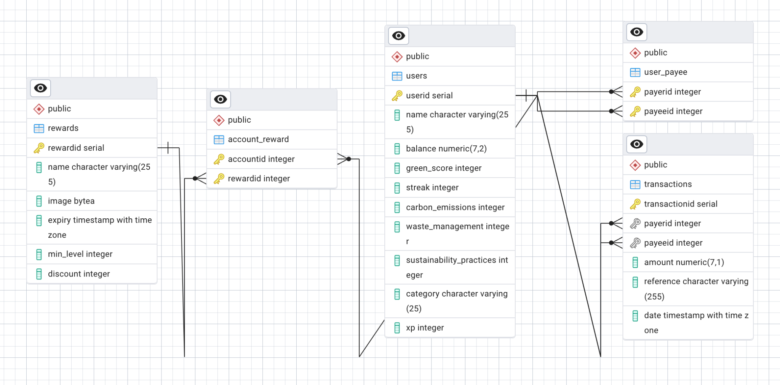
Database Structure

Slide 7
Week 2
Development started
Database and all tables were created in RDS
Started work on the webpages, API and PLPGSQL Procedures.
Solid progress for development

Slide 8
Gamification
Keep users engaged by adding a streaks system, which increments with daily green transactions.
Rewards section where the user can claim different rewards from our various partners such as Greggs and Costa Coffee.
Future plans include giving the admin team more power to choose the third-party partners.

Slide 9
Week 3
Finalising development work
Working on meeting requirements
Testing the product.

Slide 10
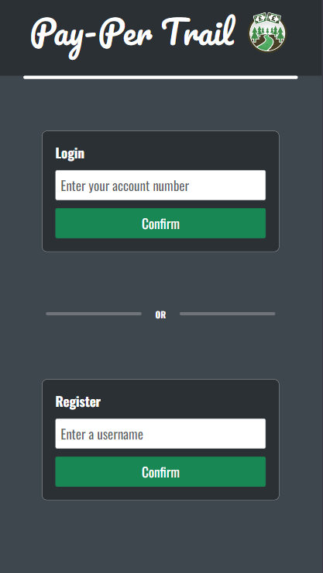
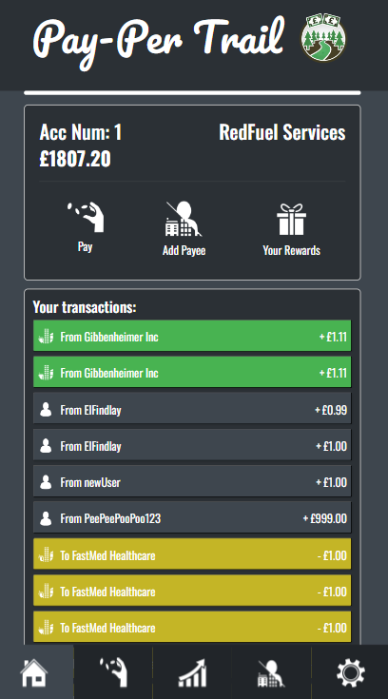
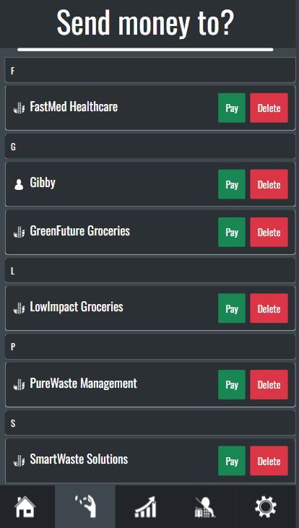
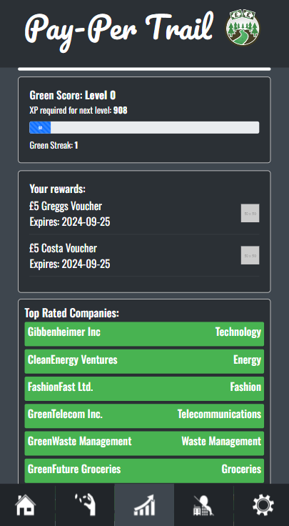

Live Demo

Slide 11


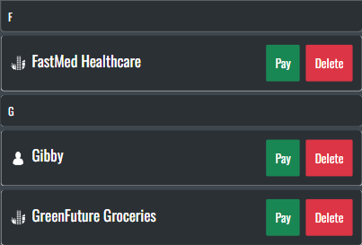
Design Decisions
Aimed for a minimalistic design
Used different logos for person and company to easily identify transactions.
Used a contacts list approach to search for payees when sending money.

Slide 12
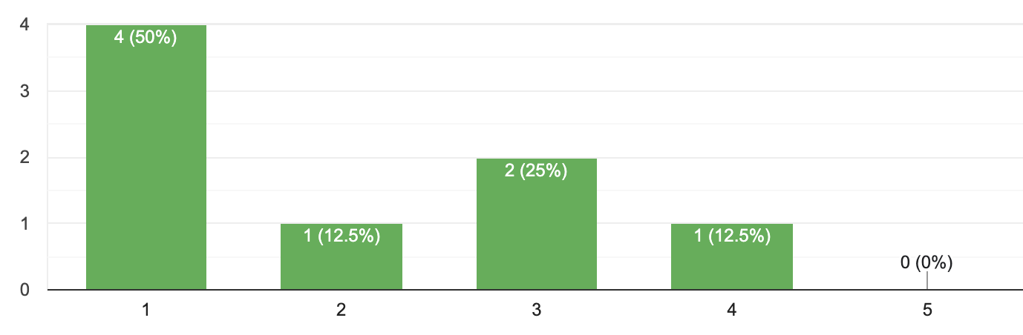
User Testing
Questionnaire
Instructions to complete tasks

Slide 13
Future Work
Technology improvements
Additional Features
Encryption for access and data storage

Slide 14
Q&A
Thank you! :)

